Slide 1
Display Week 2017 Exhibitor Survey Revised
Monday, July 17, 2017

Slide 2
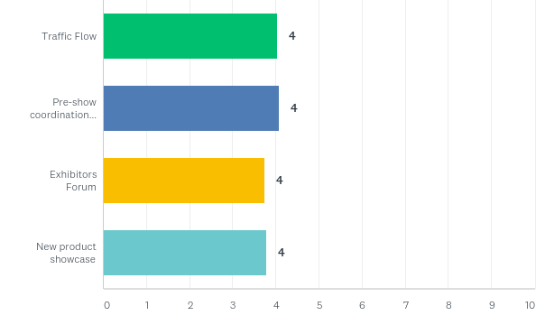
Q1: Please rate the following components of the exhibition.

Slide 3
Q1: Please rate the following components of the exhibition.

Slide 4
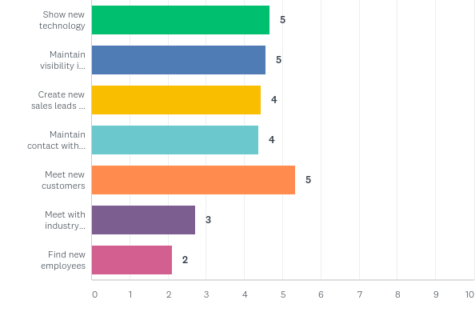
Q2: The primary reason(s) my company exhibits at Display Week is to (please rate in order of importance):

Slide 5
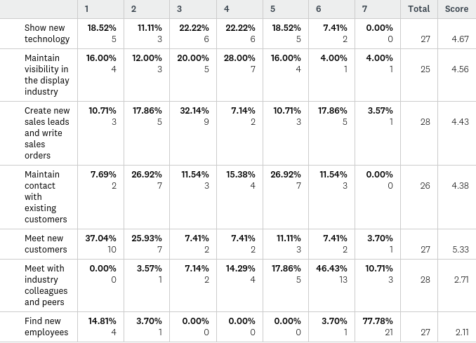
Q2: The primary reason(s) my company exhibits at Display Week is to (please rate in order of importance):

Slide 6
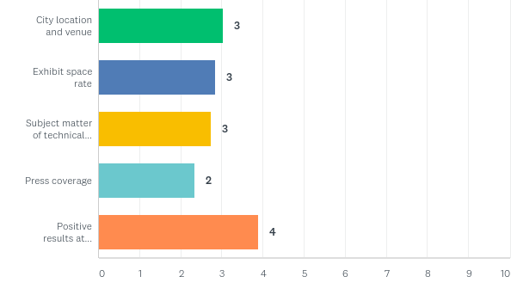
Q3: What factors will influence your decision to exhibit at Display Week 2018 (please rate in order of importance)?

Slide 7
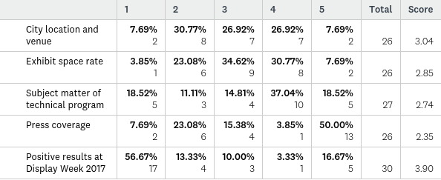
Q3: What factors will influence your decision to exhibit at Display Week 2018 (please rate in order of importance)?

Slide 8
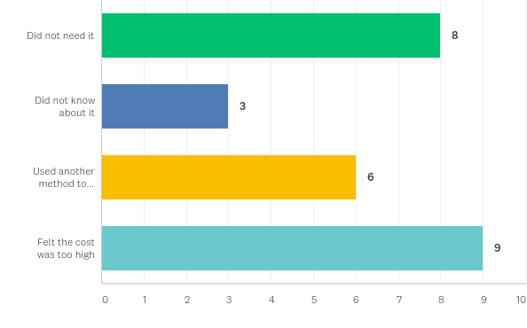
Q4: Please check the boxes that apply for the Lead Retrieval Machine:

Slide 9
Q4: Please check the boxes that apply for the Lead Retrieval Machine:

Slide 10
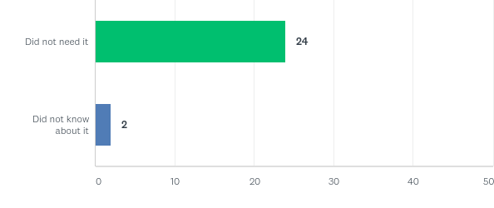
Q5: Please check the boxes that apply to the mobile app:

Slide 11
Q5: Please check the boxes that apply to the mobile app:

Slide 12
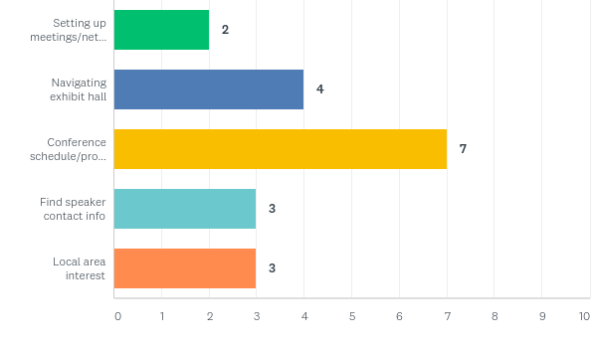
Q6: If you downloaded the mobile app, what features did you find most useful?

Slide 13
Q7: What best describes your position within your organization?

